Slide 1


SSOCIETY Project
Automated Threat Analysis and SOAR Integration with SIEM and Virtual Tier-1 Analyst Pipelines
GRADUATION PROJECT DEFENSE DECK

Slide 2


Executive Summary
The SSOCIETY Vision
Cognitive Engineering
SSOCITY provides an integrated virtual framework for automated log collection, analysis, and alert routing. By designing robust, modern detection rules and merging SIEM with SOAR pipelines, the project bridges security operations with cognitive reasoning.
Implementing a virtual Tier-1 Analyst powered by Generative AI ensures security threats are contextualized and contained within milliseconds rather than hours, reducing overhead costs and alert fatigue significantly.
Slide 2 / 25
SSOCITY Executive Summary

Slide 3
Presentation Agenda
01. Introduction & Cyber Threat Landscape (Slides 5-8)
04. SOAR Playbooks & AI Triage (Slides 19-22)
02. Lab Architecture & Design (Slides 9-13)
05. Validation, Hurdles & Future Scope (Slides 23-25)
03. Customized Detection Engineering (Slides 14-18)
Slide 4 / 25
Agenda Overview

Slide 4

Section 01
Cyber Threat Landscape & Traditional SOC Bottlenecks

Slide 5

The Modern Cyber Threat Wave
As corporate network architectures expand, malicious actors execute polymorphic payloads that continuously slip past perimeter signature scans.
Ransomware propagation, complex persistence scripts, and credential brute-forcing require intelligent real-time processing to counter threat velocity.

Slide 6


Traditional SOC Deficiencies
Intense Alert Fatigue
Manual Triage Latency
Static Defensive Tools
Security analysts handle thousands of static notifications, resulting in critical security events getting completely overlooked.
Identifying attacker objectives, fetching domain lists, and building mitigation commands takes hours or days to execute.
Conventional systems look strictly at basic, static signatures and hashes, failing against dynamic API execution vectors.
Slide 7 / 25
SOC Bottlenecks

Slide 7
The Cognitive Security Vision
"
"Automation is not simply about replacing human work; it is about raising the speed of cognition so that defenses stay ahead of attackers."
"
— Cognitive Security Operations Design Framework
Slide 8 / 25
Project Goal

Slide 8
Section 02
Lab Infrastructure, Isolation & Data Pipelines

Slide 9


The Smart Mini-SOC Infrastructure
Data Flow Blueprint
We created a virtualized lab environment hosting endpoints configured to stream process parameters safely to centralized indexers.
Granular event tracking at the host registry level.
Secure syslog forwarding via private host network cards.
Immediate parsing to ready logs for detection algorithms.
Slide 10 / 25
Infrastructure Overview

Slide 10


Isolated Hypervisor Setup
VLAN Segmentation
Active Snapshots
Built using VMware Workstation, isolated on host-only subnets (10.10.10.0/24). This keeps malware attacks isolated, avoiding accidental routing leaks outside the lab subnet.
Preserved baseline system states via hypervisor snapshot rules. This enables one-click recovery, keeping defensive rules safe after executing malware strains.
Slide 11 / 25
VLAN Configuration

Slide 11

Integrated Technical Stack
Infrastructure Component | Specific Role | Strategic Objective
Microsoft Sysmon | Endpoint Ingestion | Captures DLL loadings, registry modifications, and background spawns.
Splunk Forwarder | Secure Streaming | Encrypts local process events for transport.
Splunk Enterprise | Core SIEM Indexer | Parses data patterns with custom SPL queries.
n8n Automation | SOAR Engine | Translates alert conditions into API webhook payloads.
Google Gemini AI | Cognitive Analyst | Processes unstructured event lines into mitigation advice.
Slide 12 / 25
SOC Tech Stack

Slide 12




Data Ingestion Lifecycle
1. Generate
2. Forward
3. Index
4. Evaluate
5. Trigger
Host executes a process; Sysmon captures context.
Splunk UF ships compressed JSON strings.
Events parse into indexed sourcetypes.
SPL scheduled alerts scan the database.
Alert triggers webhook out to SOAR pipelines.
Slide 13 / 25
Log Lifecycle Timeline

Slide 13
Section 03
Custom Detection Engineering & MITRE ATT&CK Mapping

Slide 14
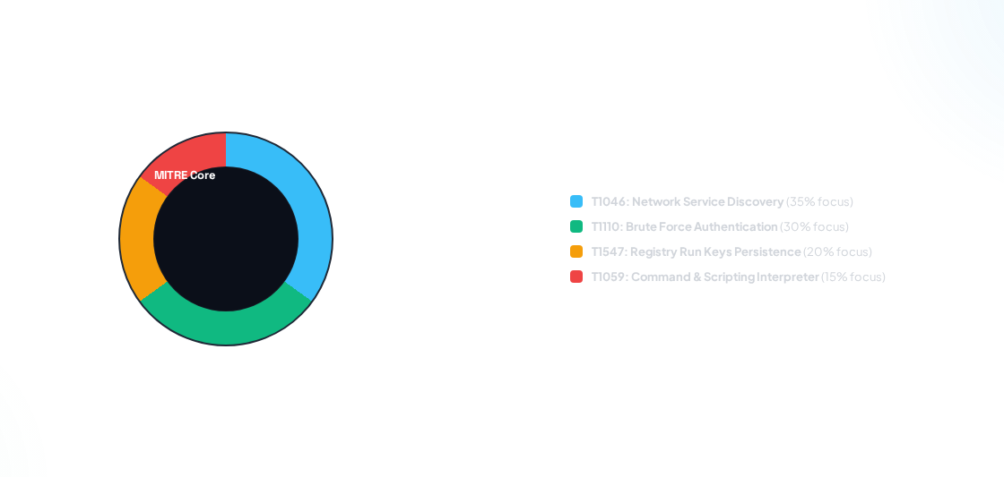
MITRE ATT&CK Framework Mapping
Slide 15 / 25
MITRE Detection Focus

Slide 15


Detection 1: Brute Force Attacks
Telemetry Logic
Aggregation Filter
Targets Event ID 4625 (An account failed to log on) within Windows Security logs. Standard systems log these raw events endlessly without grouping, causing major alert backlogs.
SPL logic counts failures per target IP address. If attempts exceed 20 failed logins within 5 minutes, we mark it malicious, extract the source IP, and dispatch an active threat packet.
Slide 16 / 25
Detection Logic 1

Slide 16


Detection 2: Fileless Script Abuse
Process Command Audits
Keyword Identifiers
Targets Sysmon Event ID 1 (Process Creation). Traditional antivirus tools often miss scripts executing commands inside legitimate host processes like powershell.exe.
Our Splunk alert monitors arguments for obfuscation patterns such as -EncodedCommand, IEX, DownloadString, or hidden window execution strings.
Slide 17 / 25
Detection Logic 2

Slide 17


Detection 3: Registry Persistence
Key Modification Tracking
Alert Trigger
Monitors Sysmon Event IDs 12, 13, and 14 (Registry Event). Attackers often establish persistence by adding values inside startup registry paths.
Fires instantly when values write to HKLM\Software\Microsoft\Windows\CurrentVersion\Run paths. Isolates the specific system path to help analysts locate and remove registry keys.
Slide 18 / 25
Detection Logic 3

Slide 18
Section 04
SOAR Integration & Cognitive AI Triage

Slide 19
SOAR Logic & Playbooks
Webhook Ingest
Parsing Data Nodes
API Routing
Splunk acts as our primary sensor, dispatching real-time JSON alert blocks to n8n webhook listener endpoints.
Custom Javascript logic strips diagnostic headers, extracting pure domain arrays, host IP addresses, and user profiles.
Coordinates sub-workflows to scan bad domains, query reputation databases, and request AI analysis simultaneously.
Slide 20 / 25
SOAR Orchestration

Slide 20
Threat Intel Enrichment
100%
VirusTotal API Integration
Before notifying security teams, extracted domain items are sent to VirusTotal. This identifies malicous file associations, preventing analyst notification overload.
Automatic Reputation Scanning
Slide 21 / 25
Threat Enrichment

Slide 21


AI Analyst Integration
Virtual Tier-1 Agent
We integrate Google Gemini directly into the n8n logic flow. Gemini acts as an autonomous tier-1 analyst, processing unstructured logs into simple, actionable summaries.
Gemini analyzes the threat vector, ranks the risk level, and generates precise containment code blocks (such as firewall block commands or PowerShell shutdown scripts) inside Slack alert channels.
Slide 22 / 25
Cognitive Triage

Slide 22
Section 05
Technical Challenges, Validation & Conclusion

Slide 23


Engineering Challenges Solved
SIEM-to-SOAR Latency
Nested JSON Formats
API Key Limits
Challenge:
Challenge:
Challenge:
Standard Splunk alerts query databases on fixed schedules, introducing response delays. Resolved by implementing HTTP POST alerts directly inside search routines.
Sysmon generates deeply nested, verbose event objects. Resolved by deploying Javascript pre-processors inside n8n node structures to normalize the data.
Free threat intelligence APIs limit query volumes. Resolved by implementing a local cache database within the n8n pipeline to prevent duplicate scanning on known secure assets.
Slide 24 / 25
Hurdles Addressed

Slide 24

Thank You for Your Attention
The SSOCIETY platform demonstrates how cognitive automation reduces security response times from hours to milliseconds. Open to your questions.
Location: Helwan International Technological University (HITU)
|
Tech Stack: Splunk, n8n, VirusTotal, Gemini AI
Slide 25 / 25
SSOCITY Final Defense Slide

Slide 25



Image Sources
https://static.vecteezy.com/system/resources/thumbnails/036/782/202/small/ai-generated-high-performance-ai-supercomputer-ai-generated-photo.jpg
Source: www.vecteezy.com
https://static.vecteezy.com/system/resources/thumbnails/077/018/596/small/3d-render-futuristic-data-stream-background-with-glowing-blue-digital-lines-abstract-technology-concept-for-network-cyber-security-big-data-communication-ideal-for-modern-backdropss-video.jpg
Source: www.vecteezy.com
https://png.pngtree.com/thumb_back/fw800/background/20260120/pngtree-artificial-intelligence-cpu-processor-on-circuit-board-with-glowing-brain-digital-image_21148883.webp
Source: pngtree.com

